Slide 1

The Solution to the Venous Catheter Tip Controversy

Slide 2
“Doctors love progress. They just hate change.”
“Radiographs don’t lie –
Radiologists do.”

Slide 3
Why am I here?
Mandate from you – Two years ago at AVA, Sherlock 3CG breakfast presentation sponsored by BARD
To show you how I have developed the concept of Sweet Spot™
Introduce you to the Sweet Spot™ website
To have you critically assess the website in hopes of improving/expanding it
REALITY CHECK!
* How you respond to my presentation will help determine the fate of the Sweet Spot™

Slide 4
AVA 2011 Sherlock 3CG Presentation
Of the 70 catheters where Maximum P-wave was obtained, ECG guidance and tip confirmation of PICC placements resulted in 100% (70/70) correctly placed PICCs at the CAJ (from March 28, 2011 to May 1, 2011) when compared with the CXR. These catheter tips were determined to be at the CAJ, i.e., within +/- 1cm of the vertical center of the “sweet spot.”
Following the initial trial, data has been continually collected to gain more experience and stronger statistics. As of July 15, 2011 there were a total of 220 ECG positioned PICCs at PSHMC and 75 at PHFH with the same results as above. At this time, it was decided to formally request a change in policy to stop getting routine post procedure CXRs for PICC placed using ECG guidance.

Slide 5
WHY A TRADEMARK STATUS?
Control the educational message
Maintain the quality of the concept
Maintain the integrity of the concept
Potentially offset considerable expenditures of time and money
Protect my intellectual property interests

Slide 6
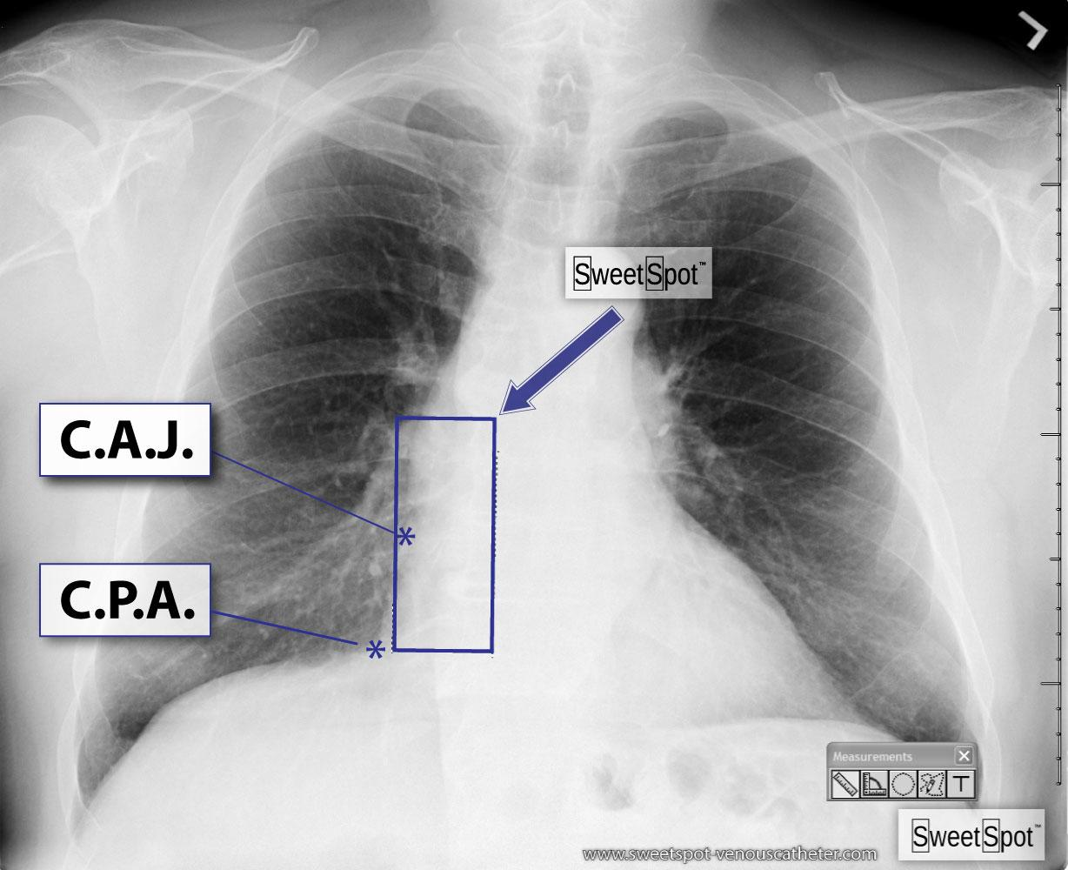
www.sweetspot-venouscatheter.com
Started October 2011
Finished January 2013

Slide 7
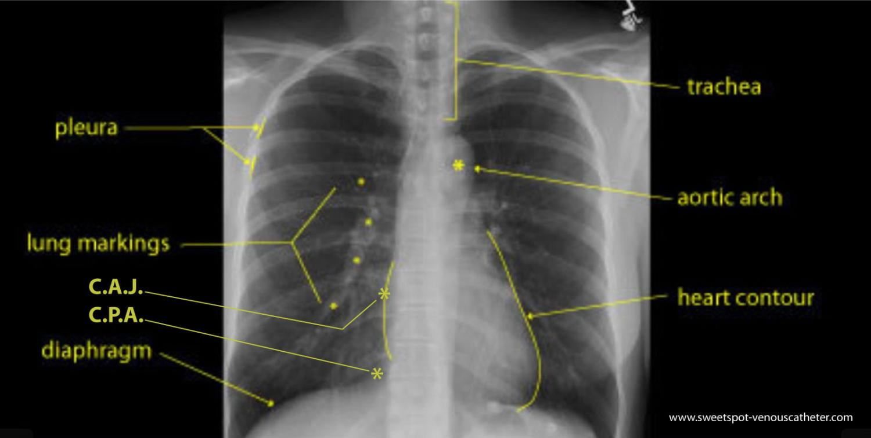
The Anatomy of the Frontal Chest X-Ray

Slide 8
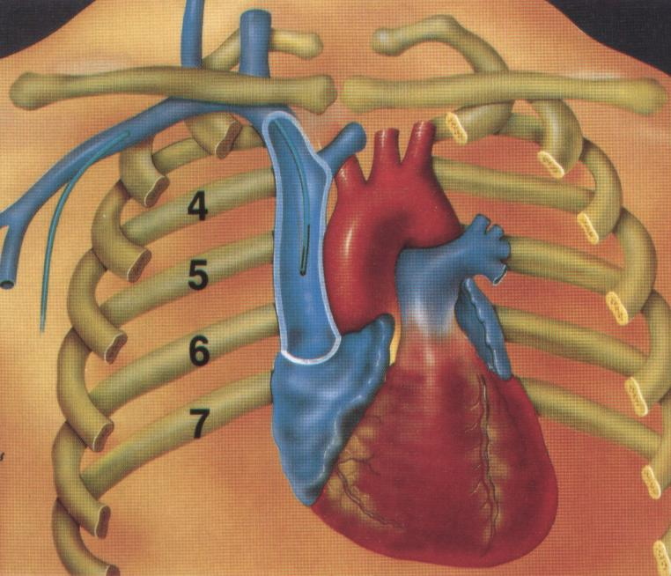
Historical Catheter Tip Location and Reported Malfunction Rates (Peterson, J AM Sug 1999)1
86 %
31 %
6 cm
16 %
4 cm
2 cm
14 %
1.2 %
Petersen et al, Am J Surg 1999, 178:38-41
Notes:
This may be a good slide to discuss the sweet spot. I will have pictures of it in the handout packet

Slide 9
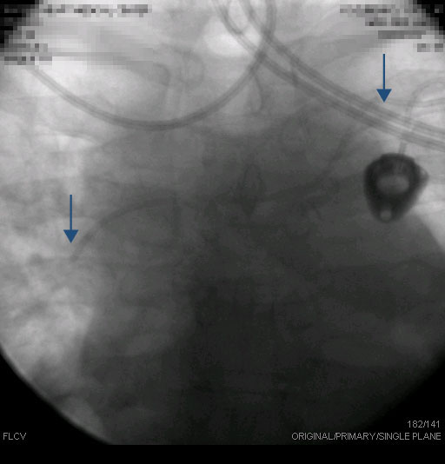
A recent case
Notes:
Advance to reveal CXR.

Slide 10
ORIGIN OF SWEET SPOT™
The SWEET SPOT™ was created for two main reasons. The first was to improve patient safety by decreasing the complications caused by improperly positioned venous access devices (VAD) as encountered by me and other members of my IR practice. The second was to remove the always subjective and sometimes erroneous chest x-ray (CXR) interpretation of VAD tip position (as well as resultant unnecessary recommendations for repositioning) in my own large and highly sub-specialized radiology group (55 members at present).
Notes:
Advance to reveal CXR.

Slide 11
DEFINITION OF SWEET SPOT™
The SWEET SPOT™ is a rectangular template superimposed on a frontal CXR, whose margins and internal area are acceptable for VAD catheter tip position. This is tailored to the individual patient's chest x-ray. As such, it has no fixed length or width but does have fixed proportions with the craniocaudal length being twice the width on a frontal chest x-ray. Depending on patient anatomy, it can exceed 8 x 4 cm. The template is simply compared in size to the CXR at hand. This template is very easy to memorize and just as easy to teach.
Notes:
Advance to reveal CXR.

Slide 12
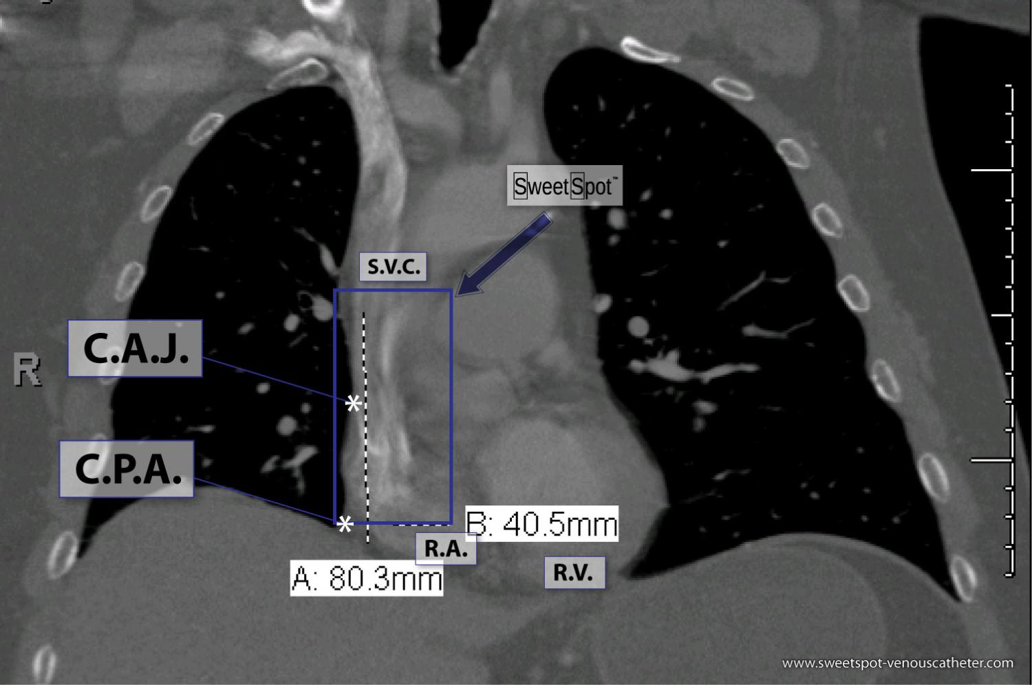
Notes:
Advance to reveal CXR.

Slide 13
The SWEET SPOT™ also has a fixed center point. It is centered over what I believe is the most accurate radiographic estimation of the cavo-atrial junction, i.e. on a frontal CXR, the initial outward bulge of the lower right cardiomediastinal margin due to the transition from the smaller, more tubular superior vena cava to the more capacious and rotund right atrium. It was designed to be twice as wide as the lower third of the SVC to allow for the curving course of many catheter tips as they enter the right atrium - especially with left-sided access. The SWEET SPOT™ extends from the lower third of the SVC to the most inferior extent of the right atrium - stopping at the frontal CXR's cardiophrenic angle.
Notes:
Advance to reveal CXR.

Slide 14
Notes:
Advance to reveal CXR.

Slide 15
The SWEET SPOT™ is the best anatomically based and radiographically confirmed practical approximation of the cavo-atrial junction. It is independent of patient factors such as age, size, patient position for chest x-ray, lung volume or type of VAD. It also encompasses the various leading societal recommendations for catheter tip location. As such, it allows for the necessary significant flexibility in acceptable VAD tip location based not only on patient, chest x-ray and catheter variables as just mentioned but also inserter variables such as societal affiliations, personal experience and personal convictions.

Slide 16
CLINICAL USE OF SWEET SPOT™
It was initially adopted practice wide by my group — Inland Imaging, Spokane, Washington in 2007 as the sole acceptable chest x-ray standard for VAD tip location - which it still is. As such, it also became the standard of acceptability for our recently completed Sherlock 3CG trial. (Approx. 2,700 PICCs/year in Spokane or 19,000 PICCs since Sweet Spot™ adopted.)
In this same trial, the vast majority of the Sherlock 3CG guided catheter tips — whose technology targets the S.A. node, were at the center of the SWEET SPOT™, i.e. the radiographic cavoatrial junction, thus confirming both chest x-ray and ECG methods of catheter tip verification. The two methods, therefore, cross-validate and have the same end point — optimal VAD tip location.
Notes:
Advance to reveal CXR.

Slide 17
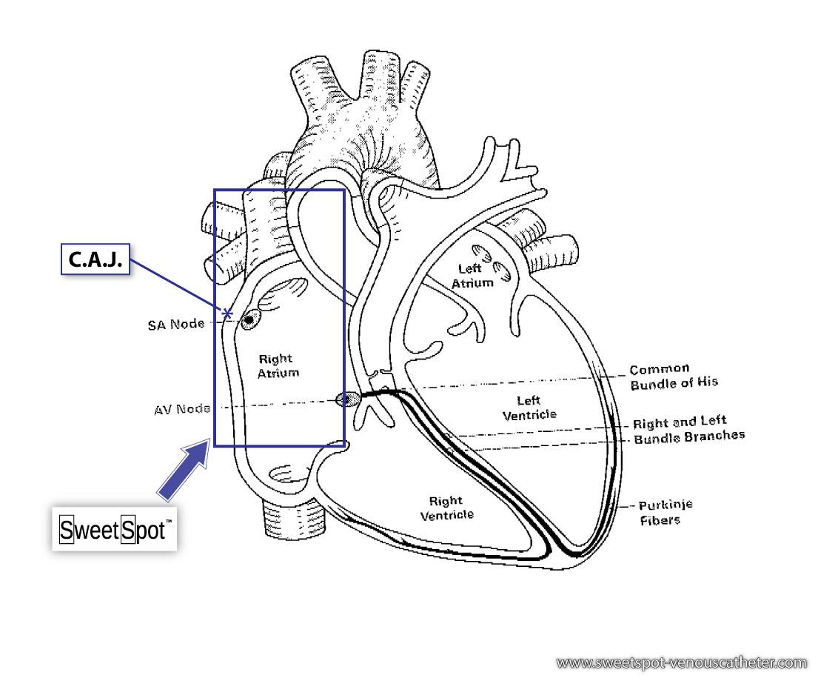
Cardiac conduction pathways
Notes:
Advance to reveal CXR.

Slide 18
SOCIETAL RECOMMENDATIONS FOR V.A.D. CATHETER TIP LOCATION
In 1989, the US FDA (Task Force FDA Drug Bulletin 1989:15) issued an advisory statement that it is unacceptable for catheter tips to be placed or permitted to migrate into the heart for fear of cardiac tamponade.² During this time, other studies provided evidence that catheter tips placed high in the SVC or outside the SVC increase the risk of thrombus and catheter malfunction. (Kearns³, Caers⁴, Cadman⁵). In 1998, the National Association of Vascular Access Networks (NAVAN), published a position statement recommending that the “most appropriate location for the tip of PICCs is the lower one-third of the SVC, close to the junction of the SVC and the right atrium” and not extending into the right atrium. (NAVAN tip position).⁶
Notes:
Advance to reveal CXR.

Slide 19
SOCIETAL RECOMMENDATIONS FOR V.A.D. CATHETER TIP LOCATION
In 2006, the Infusion Nurses Society updated their Standards of Practice and again in 2011 stating that “CVC tips should be located in the lower third of the SVC to the CAJ” (INS 2011).⁷ While the authors and organizations cited above favor positioning outside the right atrium, the Society of Interventional Radiology (SIR) states (in their Quality Improvement Guidelines for Central Venous Access) that the tip should be “in the cavoatrial region or right atrium” (2010 SIR Dariushnia)⁸ and this view is also stated in the European Society of Parental and Enteral Nutrition (ESPEN) Guidelines (Pittiruti 2009).⁹ Historically this inferior migration of catheter tip position acceptability is coincident and not unrelated to manufacturers developing V.A.D.'s made out of softer materials.
Notes:
Advance to reveal CXR.

Slide 20
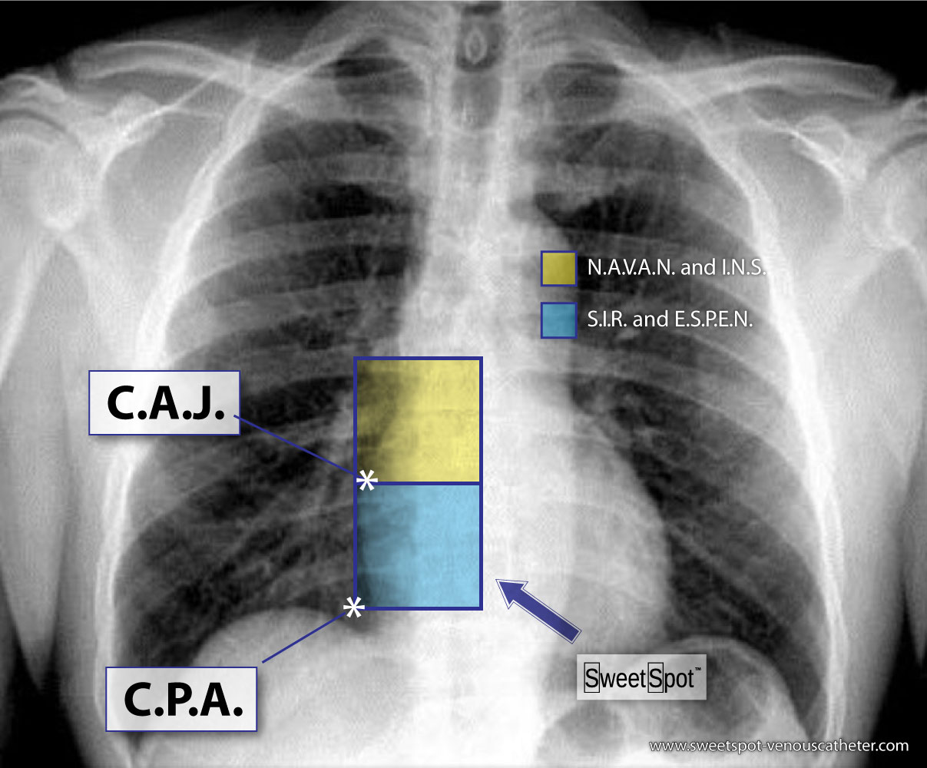
The Switzerland of societal acceptability
Notes:
Advance to reveal CXR.

Slide 21
Sweet Spot Gallery

Slide 22

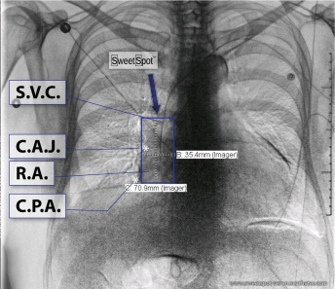
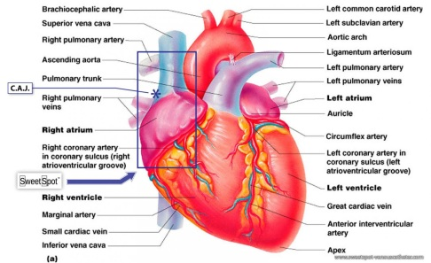
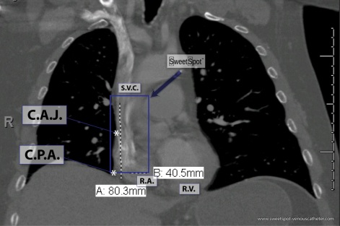
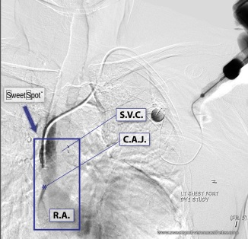
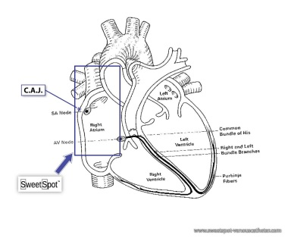
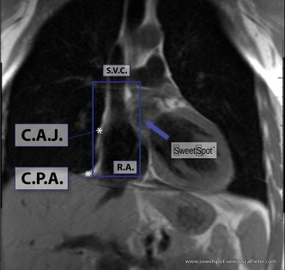
Seven Faces of The Sweet Spot ™
-- More than a CXR

Slide 23
Chest X-Ray

Slide 24
Cardiac conduction pathways

Slide 25

Gross
Anatomy

Slide 26
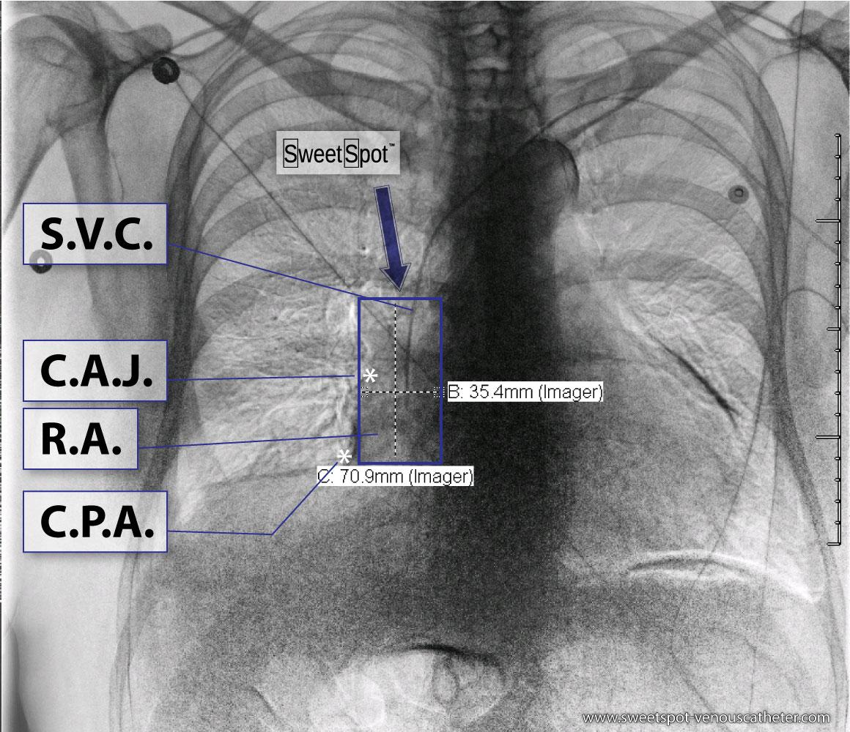
Dual Energy CXR

Slide 27
Coronal CT Scan Reconstruction

Slide 28
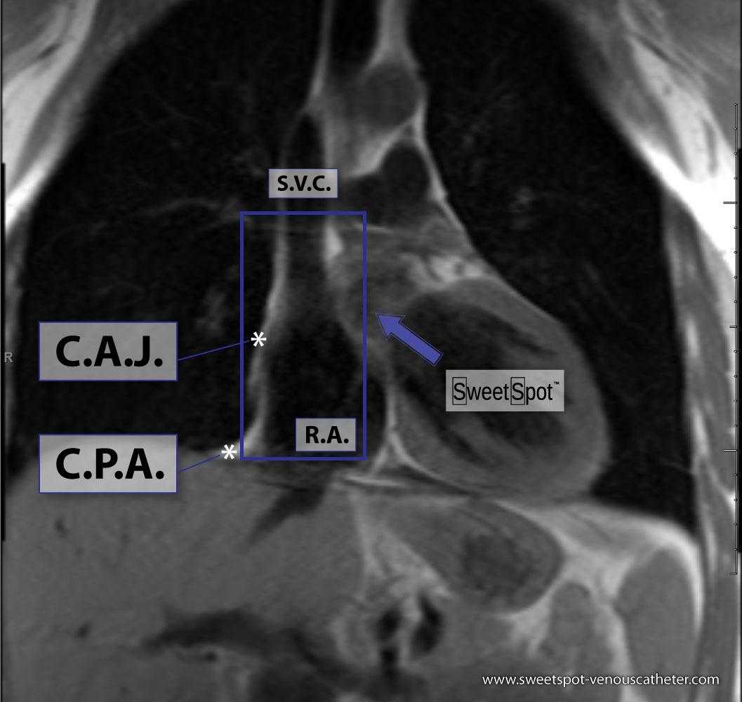
Coronal MRI

Slide 29
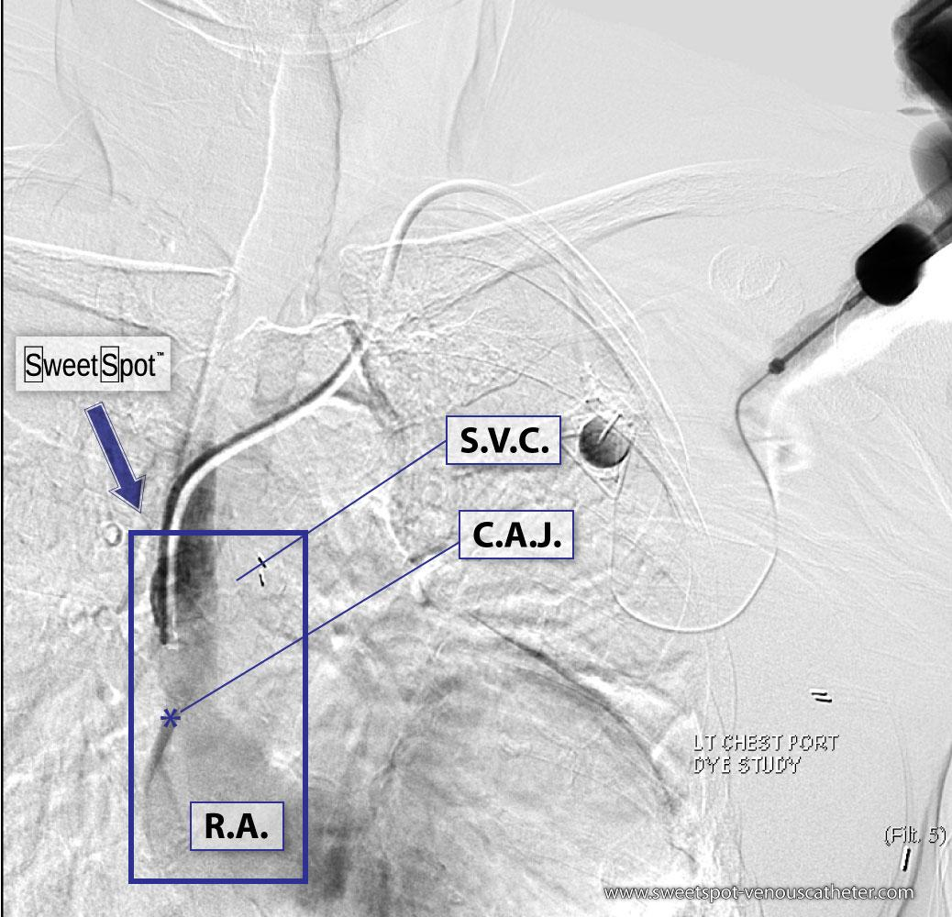
Catheter Contrast Injection

Slide 30
Teaching Points

Slide 31
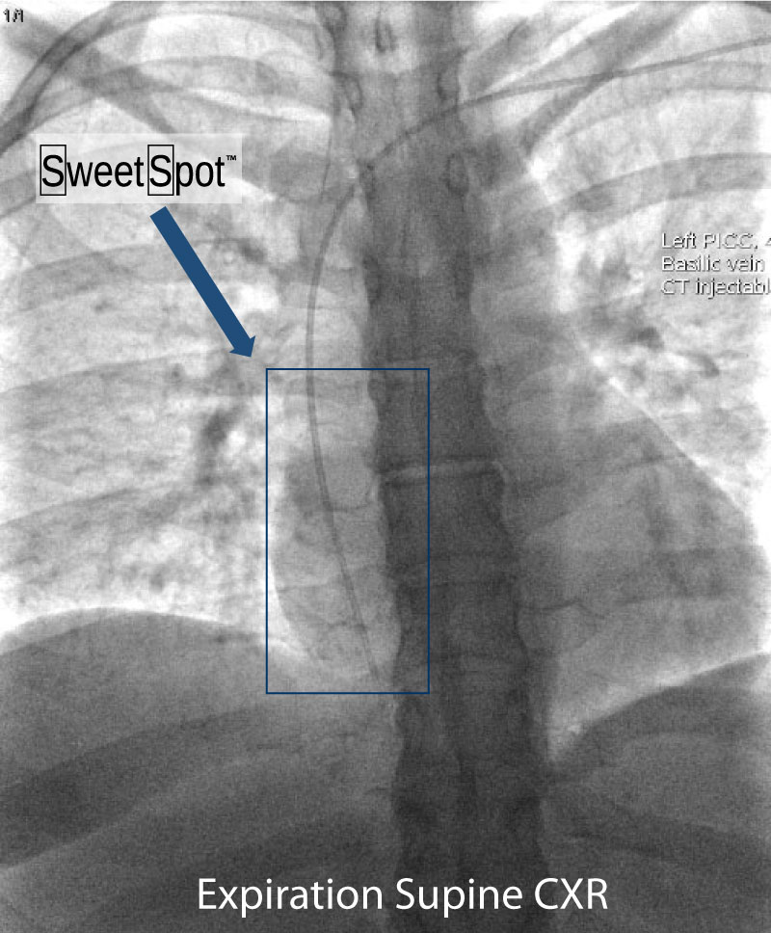
1. When I place a VAD under fluoroscopic visualization, my optimal tip position is in the bottom of the box at expiration.

Slide 32
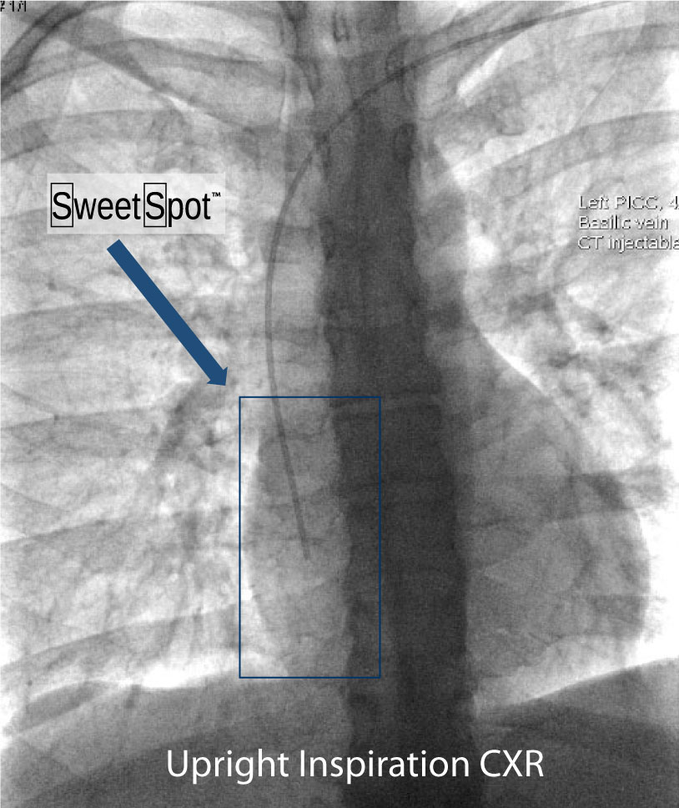
2. On inspiration upright CXR, the tip of VAD is ideally at C.A.J.

Slide 33
3. Chest x-ray rotation tissues: Not infrequently, the chest x-ray will be rotated causing the right cardiac margin to deviate from its normal AP appearance. In such situations, depending on the degree of rotation, an estimation of the SWEET SPOT™ is all that may be possible. In such circumstances, the right cardiophrenic angle is the most reliable anatomic landmark. Since the right atrium is immediately cephalad to a normally positioned right cardiophrenic angle, a reliable estimation of acceptable catheter tip location is still possible. The height, and consequently the width of the rectangular Sweet Spot™ box will be less exact. An apparently short catheter tip position may require a non-rotated chest x-ray to confirm an acceptable location.

Slide 34
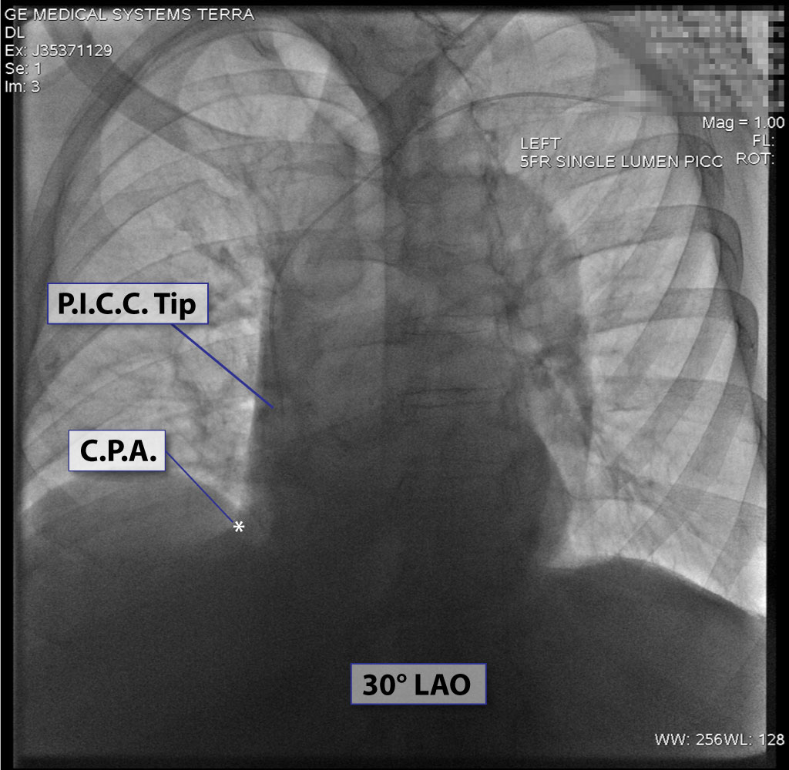

Slide 35
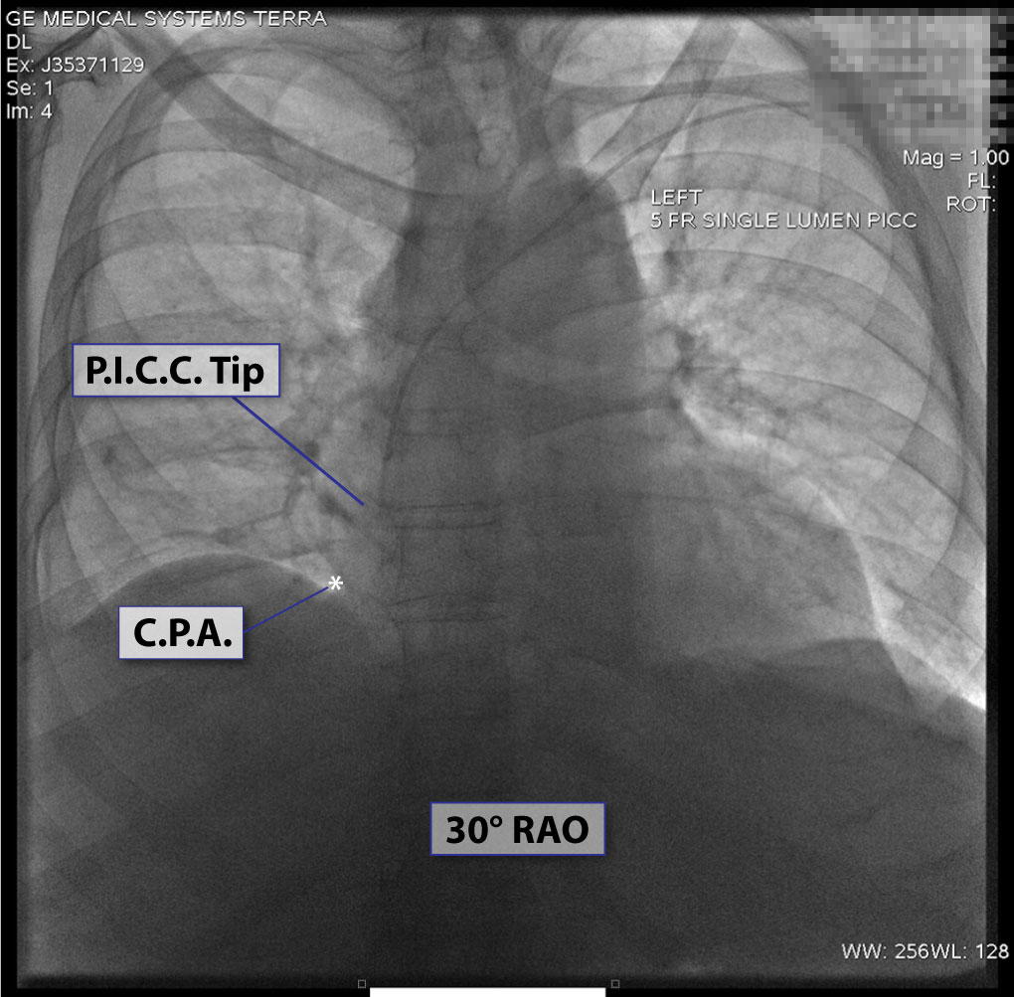

Slide 36
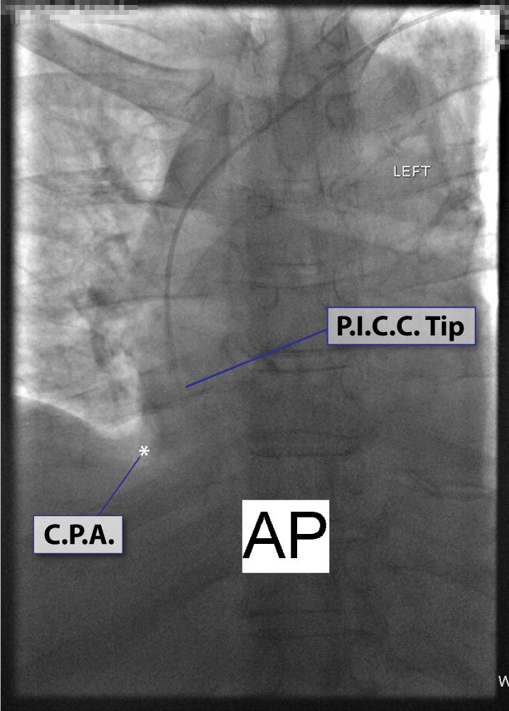

Slide 37
4. Abnormal (obscured) appearance of the right cardiac border on non- rotated chest x-ray: Again, the cardiophrenic angle is the most reliable landmark and thus the same principles apply as in teaching point #3 (ex. RML collapse).

Slide 38
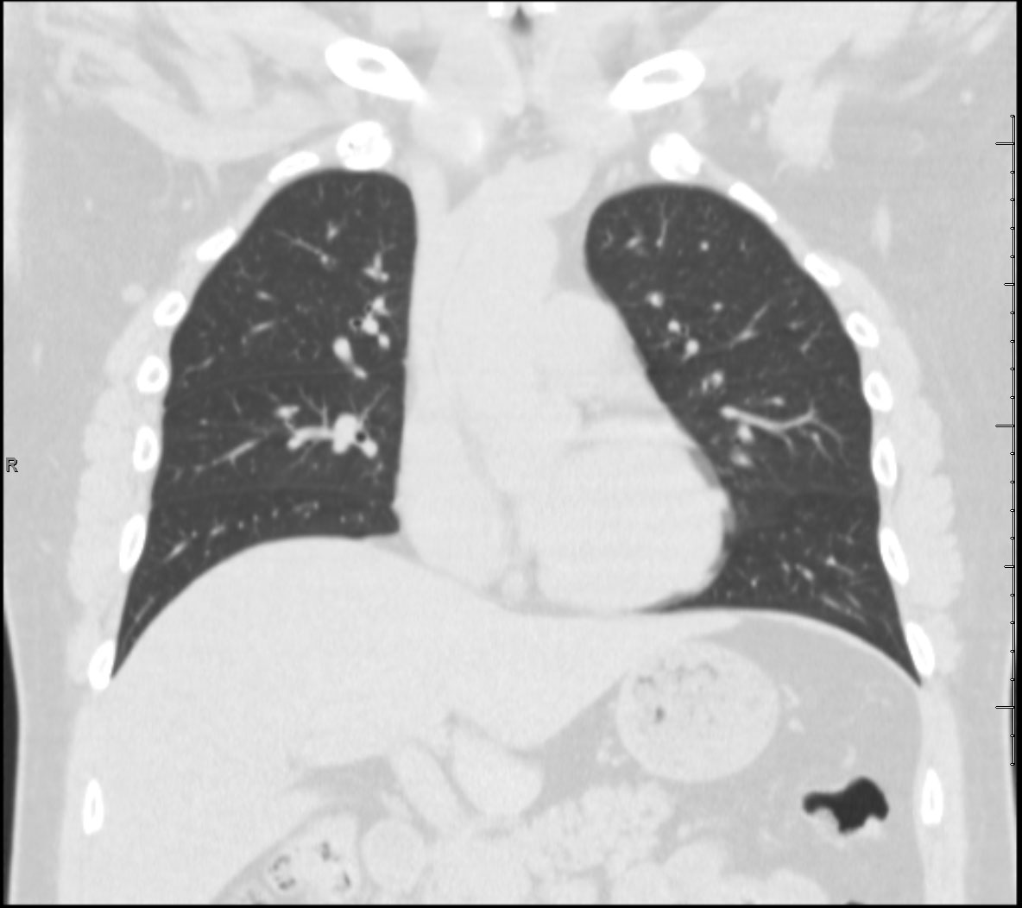
Obscured Sweet Spot™ Landmarks

Slide 39
5. Abnormal (obscured) right cardiophrenic angle: The best way to confirm a normally positioned right cardiophrenic angle is to look at the left cardiophrenic angle. Generally speaking, the right cardiophrenic angle should be at approximately the same horizontal position as the left cardiophrenic angle. In the case of an elevated right cardiophrenic angle, experience and an understanding of the underlying anatomy SWEET SPOT™ may suffice. Aim for CAJ -- is by definition always center of Sweet Spot™.

Slide 40
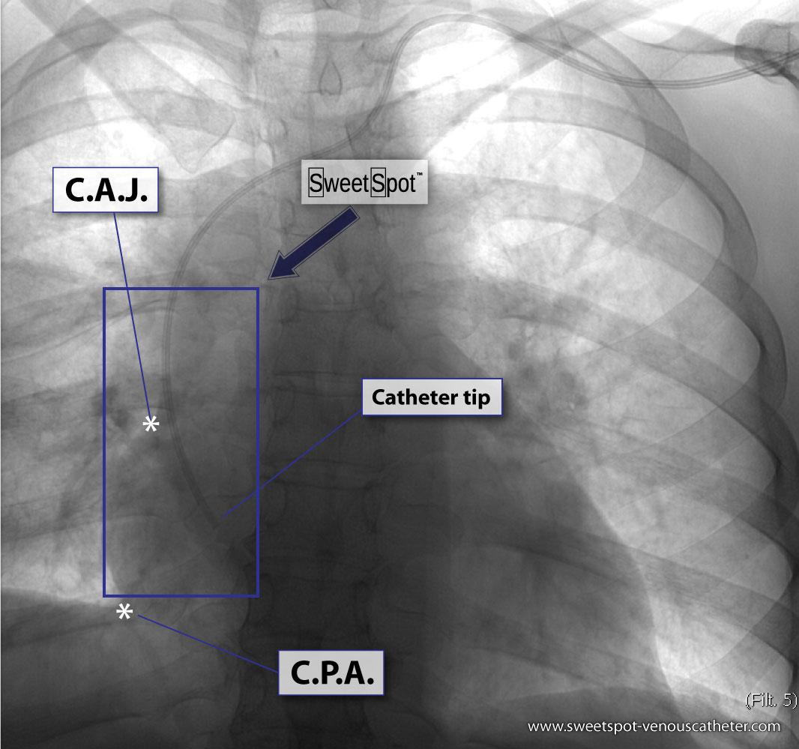
6. A left-sided approach often causes the tip of the venous access device to curve to the patient's left, necessitating a relatively wide SWEET SPOT™ design.
Example of why Sweet Spot™ needs to be so wide.

Slide 41
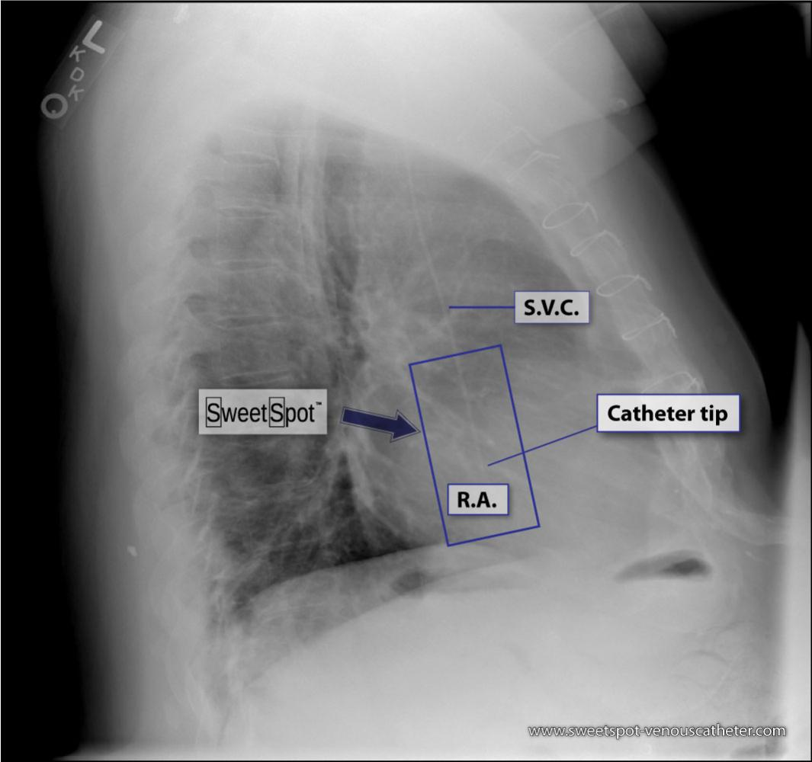
7. On a lateral chest x-ray, the catheter should course in an almost straight line from the superior vena cava into the right atrium. If it deviates posteriorly from this straight orientation, suspect that it has entered the azygos vein. If this is the case, reposition the catheter.
Lateral CXR Sweet Spot™

Slide 42
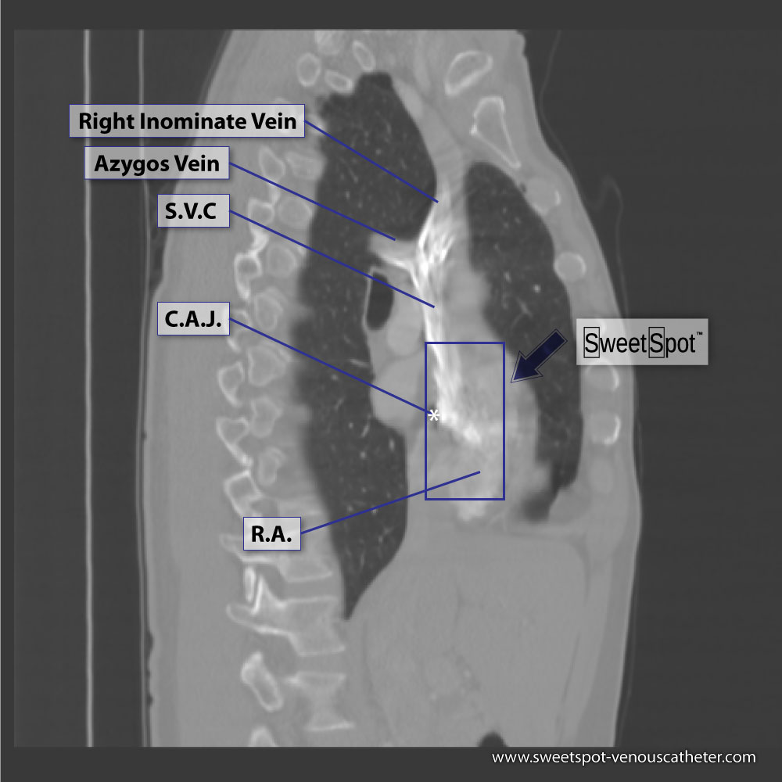
7. On a lateral chest x-ray, the catheter should course in an almost straight line from the superior vena cava into the right atrium. If it deviates posteriorly from this straight orientation, suspect that it has entered the azygos vein. If this is the case, reposition the catheter.
Sagittal CT reconstruction

Slide 43
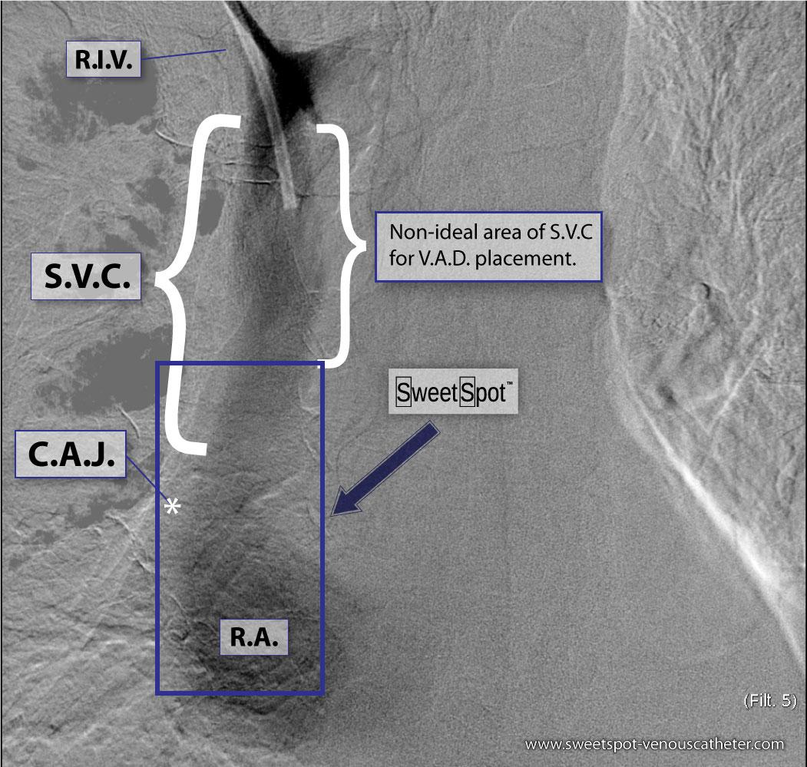
8. The superior vena cava is surprisingly long - particularly in patients with a long cardiomediastinal silhouette. Ex: COPD
Example of how S.V.C. can be very long in some patients. Right-sided V.A.D. contrast injection.

Slide 44
9. A catheter tip that is short of the SWEET SPOT™ runs the risk of flipping into the left innominate vein or the right innominate vein( depending on what side access was from) during either the cardiac and/ or the respiratory cycle-causing potential intimal injury / fibrin sleeve / thrombus, etc..
10. With lower lung volumes, both cardiophrenic angles will be in a more cephalic location relative to the mediastinum. The patient will correspondingly have a shorter and narrower Sweet Spot™.

Slide 45
11. If you find that you are having information overload, just try to memorize this image.

Slide 46
SWEET SPOT™ Limitations
Loss of radiographic landmark(s)
  Right cardiac margin (CAJ)
  One or both CPAs
Distortion of radiographic landmark(s)
  Severely rotated CXR
  Severely deformed chest (ex. Scoliosis)
  Lordotic CXR
Very low lung volumes
  Mediastinum shortens less than lungs
Solutions
  At worst, left with whatever criteria you had before (Sweet Spot™ is additive).
  Place PICC conventionally and if questionable CXR get additional cross-sectional imaging (ex. CT/MRI) Many patients are getting this anyways for their underlying medical condition.
  ECG guided PICC
* Greater than 90% applicability of Sweet Spot™

Slide 47
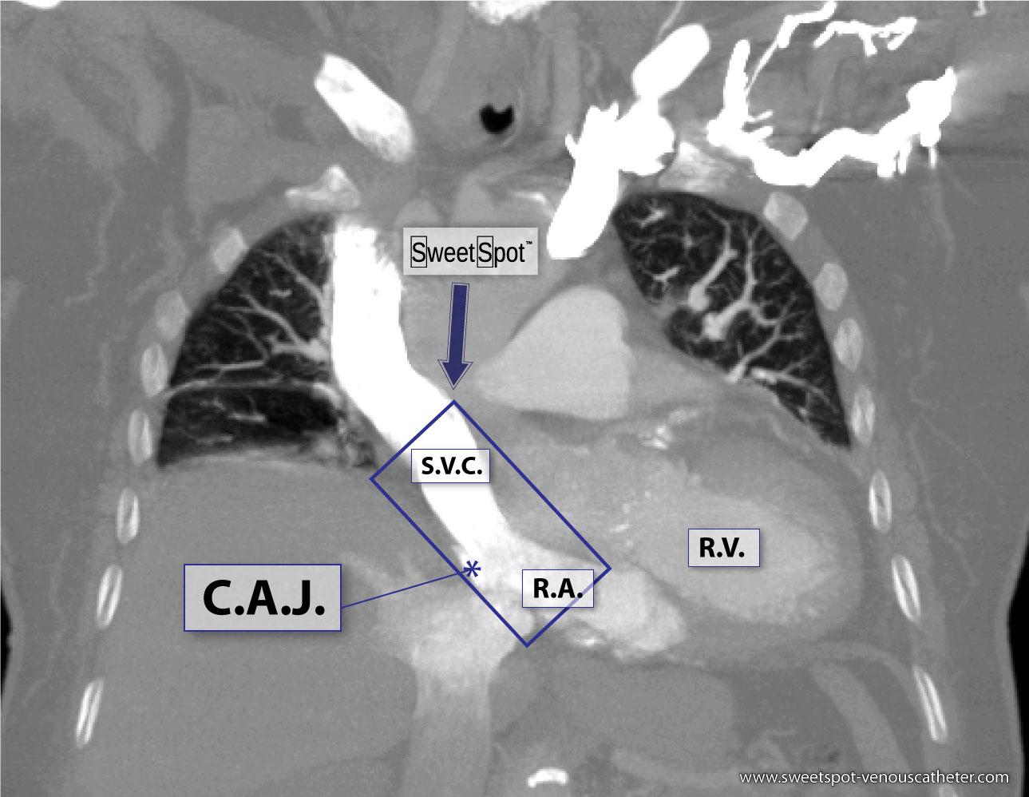
Ex. Very low lung volumes - Sweet Spot™ useless

Slide 48
Drawing the Sweet Spot™

Slide 49
On a frontal CXR, identify the CAJ and the right CPA.
Start at a point as close as possible to the CPA that permits a vertical line to be drawn along the right edge of the cardiac silhouette.
Go twice the distance of the CPA to the CAJ.
Next, continue a horizontal line to your right equaling one-half the length of the previous vertical line.
Lastly, turn inferiorly and complete the rectangle.

Slide 50
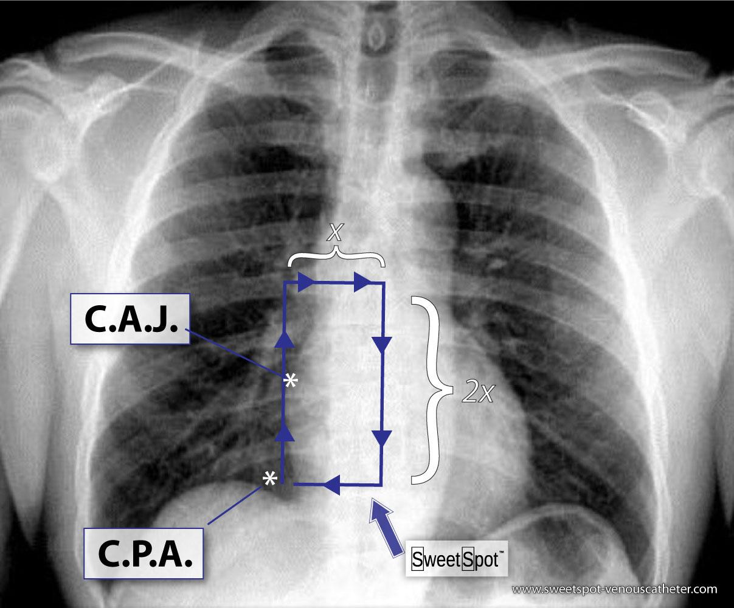
How to draw the Sweet Spot™

Slide 51
SWEET SPOT™ Summary
Practical
Objective
Allows standardization
Easy to learn
Based on clinical experience, anatomy & clinical research
Should be embraced by industry
Improves patient care
  Increase dwell times
  Decreased problems
  Decreased costs
  Decreases morbidity & mortality
    Preventing lost access
    Decreased thrombosis (↓ PE, Infection and Sepsis)

Slide 52
NEED YOUR
FEEDBACK

Slide 53
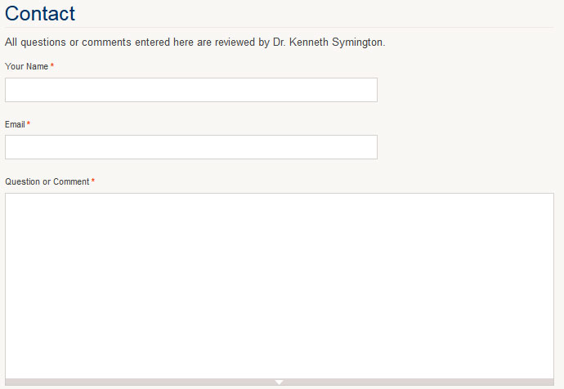
Interactive Website
www.sweetspot-venouscatheter.com

Slide 54
GOAL
Make SWEET SPOT™ the gold standard V.A.D. tip evaluation and acceptability in the United States as well as the rest of the world.

Slide 55
Please consider adopting and promoting the SWEET SPOT™.
Together we can end the confusion and the complications of catheter malpositioning.

Slide 56

“If you save a single life, it is as if you save the world.”
-The Talmud

Slide 57
THANK YOU

Slide 58
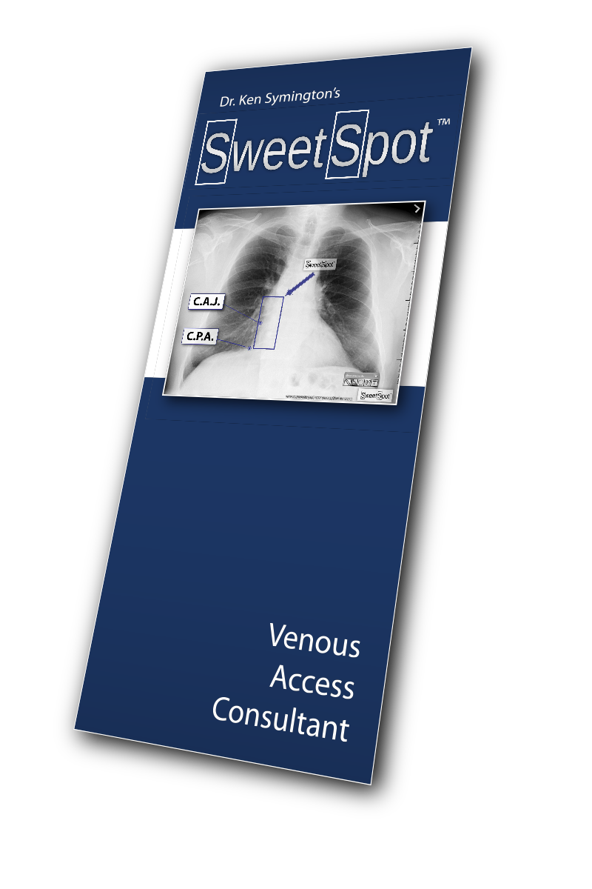
How to contact me:
EMAIL
ksymington@inlandimaging.com
WEB
www.sweetspot-venouscatheter.com
CELL (PST)
509-990-4455

Slide 59
¹ Petersen et al, Am J Surg 1999, 178:38-41
² Food and Drug Administration Task Force. (1989). Precautions necessary with central venous catheters. FDA Drug Bulletin, 15-16
³ Kearns P, Coleman S, Wehner J. Complications of long arm-catheters: a randomized trial of central vs peripheral tip location. Journal of Enteral and Parenteral Nutrition. 1996;20:20-24.
⁴ Caers J, Fontaine C, Vin-Hung V, et al. Catheter tip position as a risk factor for thrombosis associated with the use of subcutaneous infusion ports. Support Care Cancer. 2005;13:325-331.
⁵ Cadman A, Lawrance JA, Fitzsimmons L, Spencer-Shaw A, Swindell R. To clot or not to clot? That is the question in central venous catheters. Clinical Radiology. 2004;59(4):349-355.
⁶ National Association of Vascular Access Networks. NAVAN position statement on terminal tip placement. Journal of Vascular Access. 1998;3:8-10.
⁷ Infusion Nurses Society. Infusion nursing standards of practice. Journal of Infusion Nursing. 2011;34(1S):S1-S110.
⁸ Dariushnia SR, Wallace MJ, Siddiqi NH, et al. Quality improvement guidelines for central venous access. J Vasc Interv Radiol. 2010;21:976-981.
⁹ Pittiruti M, Hamilton H, Biffi R, MacFie J, Pertkiewicz M. ESPEN Guidelines on parental nutrition: Central venous catheters (access, care, diagnosis and therapy of complications). Clinical Nutrition. 2009;28:365-377. Accessed July 6, 2012

